Slide 1

JOBNAVIGO
Atharva Nimkar 22107025
Yash Nalawade 22107058
Project Guide
Prof. Ujwala Pagare

Slide 2
Outline
Introduction
Literature Survey of the existing systems
Limitations of the existing systems
Problem statement
System Design
Technologies and methodologies
Implementation
Conclusion
References

Slide 3
INTRODUCTION
The Online Job Portal is a user-friendly website designed to connect job seekers with job recruiters providing opportunities
Recruiters have the capability to post job listings according to their specific requirements
An admin oversees the entire system, ensuring data accuracy and maintaining overall control
1.1 Motivation
Enhancing user experience: Job seekers often to find relevant job listing amidst a vast array of posting.
Job recommendation systems help streamline this process by process by personalizing search results , ensuring users see jobs that align with their skills , experience , and preferences.

Slide 4
INTRODUCTION
1.2 Objectives
Ease the connection between individuals seeking employment opportunities and companies looking to hire.
Provide an easy-to-use platform with advanced search and filtering options for job seekers to find relevant job postings. Recruiters can create job posts through a step-by-step guide that prompts them to include important details like role responsibilities, required skills, and compensation.
Display latest jobs available to the user On the homepage or dashboard, prominently display the most recent job postings to keep users engaged and up to date.
Simplify the process for recruiters to create, edit, and remove job postings while ensuring they contain detailed and accurate information

Slide 5
Literature Survey of the existing system
Sr. No | Title | Author | Year | Outcomes | Methodology | Demerits
1 | [1] A survey of job recommendation system | Muhammad Abbas, umer Saeed. | 2020 | Reviews various JRS approaches and discuss their effectiveness.Emphasizes personalized recommendation for job seekers. | Explores method like content-based filtering ,collaborative filtering, and hybrid models. | Limited real-world validations, bias in the recommendation Process.

Slide 6
Literature Survey of the existing system
Sr. No | Title | Author | Year | Outcomes | Methodology | Demerits
2 | [2] Job recommender system: A Review | Rafael Moraes, Felipe A.Freire | 2021 | Provides an analysis of existing job recommender system methods, focusing on hybrid systems. | Classification Into content-Based collaborative Filtering and Knowledge Based recommen | Many Contributions lack empirical Validations; Limited scope to specific domains.

Slide 7
Literature Survey of the existing system
Sr. No | Title | Author | Year | Outcomes | Methodology | Demerits
[3] | Enhancing Job Recommendation Systems with Deep Learning Technique | Yan Zhao, Chen Li | 2018 | Proposes integrating deep learning models for better job and skill matching | Uses Deep Neural Networks (DNN) and hybrid approaches to improve recommendation quality | Computationally expensive and requires large datasets

Slide 8
LIMITATION OF EXISTING SYSTEM
Limited Personalization:
Existing systems often provide generalized job recommendations based on broad criteria such as job title, location, or industry. These systems lack the ability to provide personalized suggestions based on a user’s specific skills, career goals, and preferences, reducing relevance.
Static Data Processing:
These systems often use static data, such as the information on a resume or a job description, which does not adapt in real-time to changes in the job market or user preferences. This can lead to outdated recommendations that do not reflect current trends or user needs.

Slide 9
Problem statement
In today’s rapidly evolving job market, candidates often face challenges in discovering job opportunities that align with their skills, interests, and career goals. Simultaneously, employers struggle to find suitable candidates who match the requirements of open positions.
Traditional job search platforms rely on keyword-based matching, which can lead to irrelevant recommendations for candidates and inefficient hiring processes for companies.

Slide 10
System Design
JOBNAVIGO
User login
JOBS
Admin login
Recruiter’s login
All Users
All Recruiters
Add jobs
Job list
Candidates Applied
ACCEPT Candidates
REJECT
Candidates

Slide 11
Technologies and methodologies
1.FRONT END :-
HTML 5
CSS 4.15
BOOTSTRAP
2. BACK END
Django 4.2.5

Slide 12
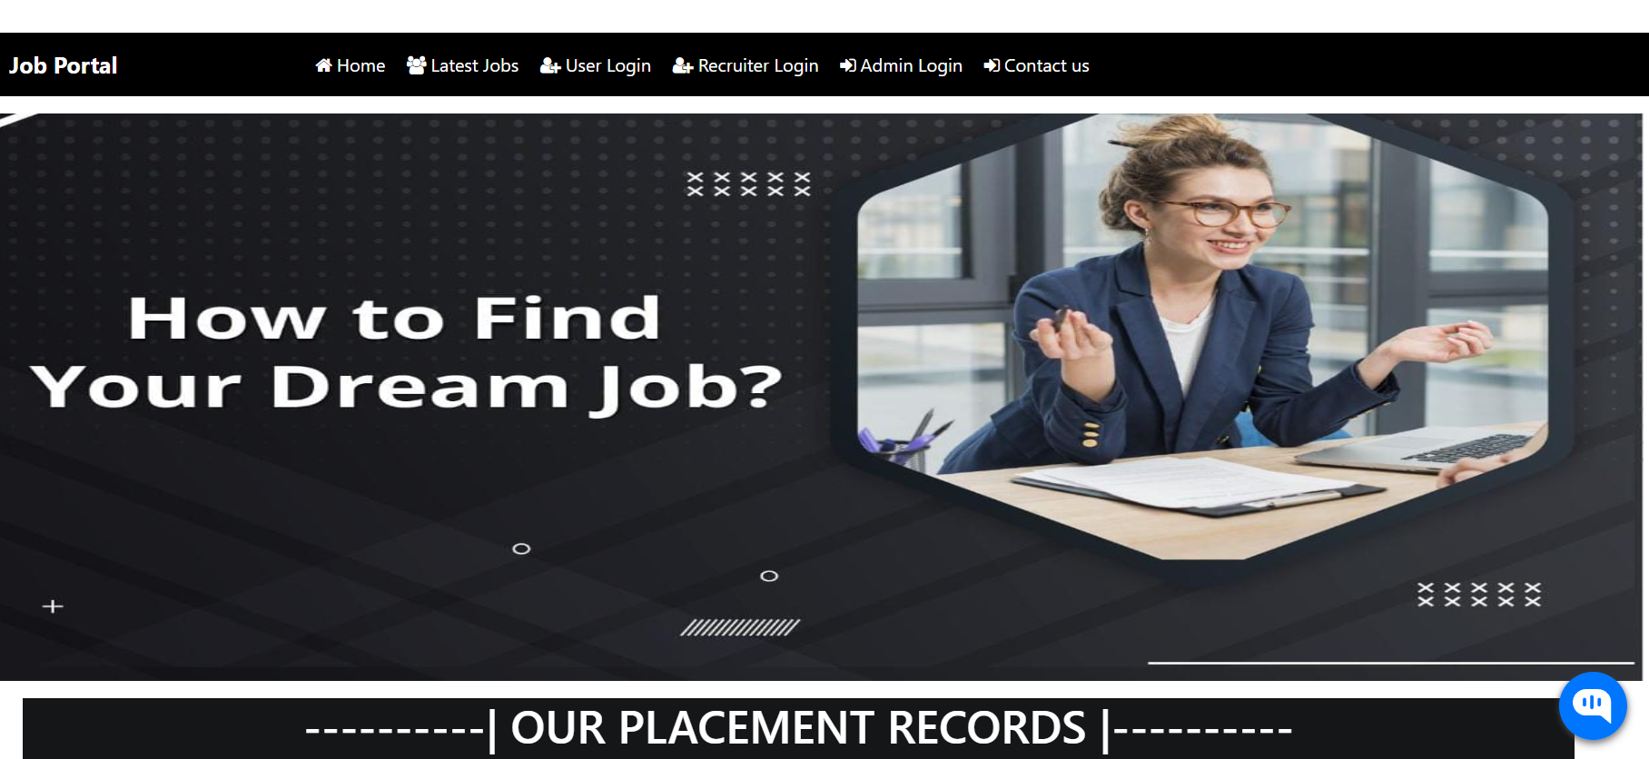
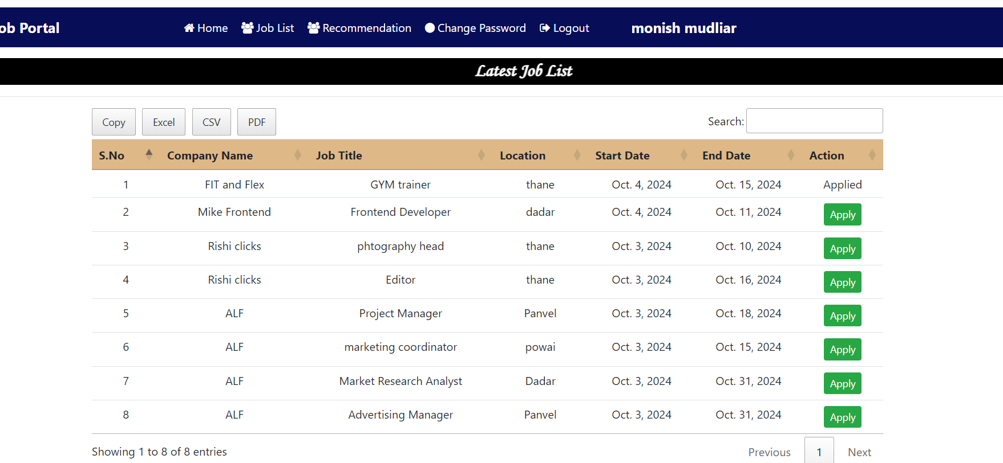
Implementation

Slide 13
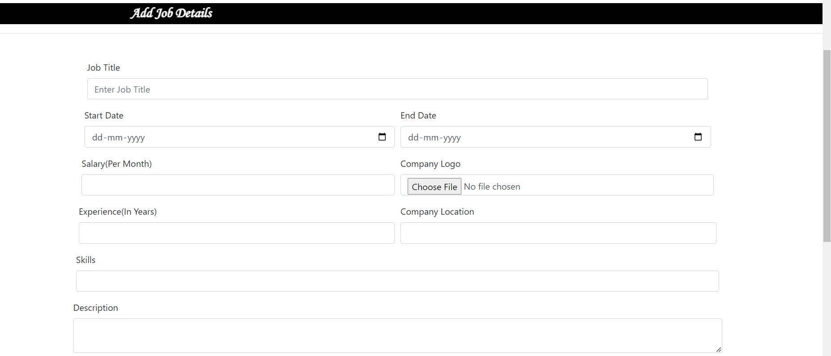
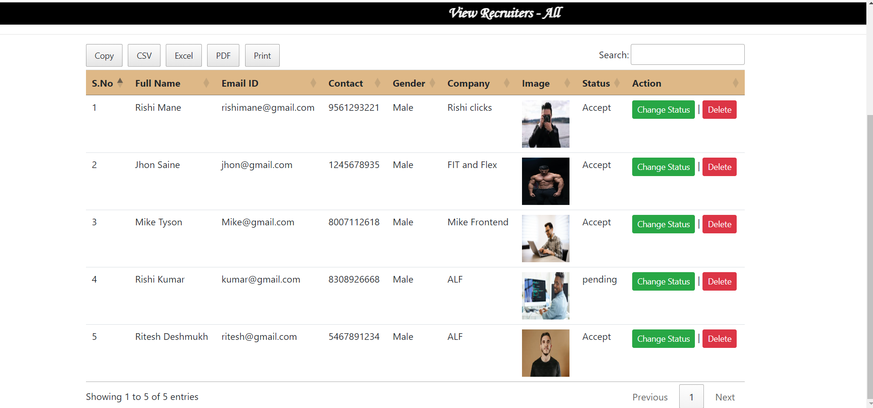
Implementation

Slide 14
Conclusion
In this project, we developed a rule-based job recommendation system that efficiently matches job seekers with potential opportunities without the use of AI or machine learning.
This approach is cost-effective, easy to maintain, and suitable for environments where transparency and deterministic decision-making are critical.

Slide 15
References
[1]
Abbas, M., & Saeed, U. (2020). A Survey of Job Recommendation Systems. International Journal of Computer Applications.
[2]
Moraes, R., & Freire, F. A. (2021). Job Recommender Systems: A Review. Journal of Information Systems.
[3] Zhao, Y., & Li, C. (2018). Enhancing Job Recommendation Systems with Deep Learning Techniques. IEEE Transactions on Knowledge and Data Engineering​.

Slide 16
Thank You...!!

